Slide 1
JNCIS-ENT
Layer 2 switching and VLANs

Slide 2
Switched Network Design
4
Hierarchical modular design concepts

Slide 3
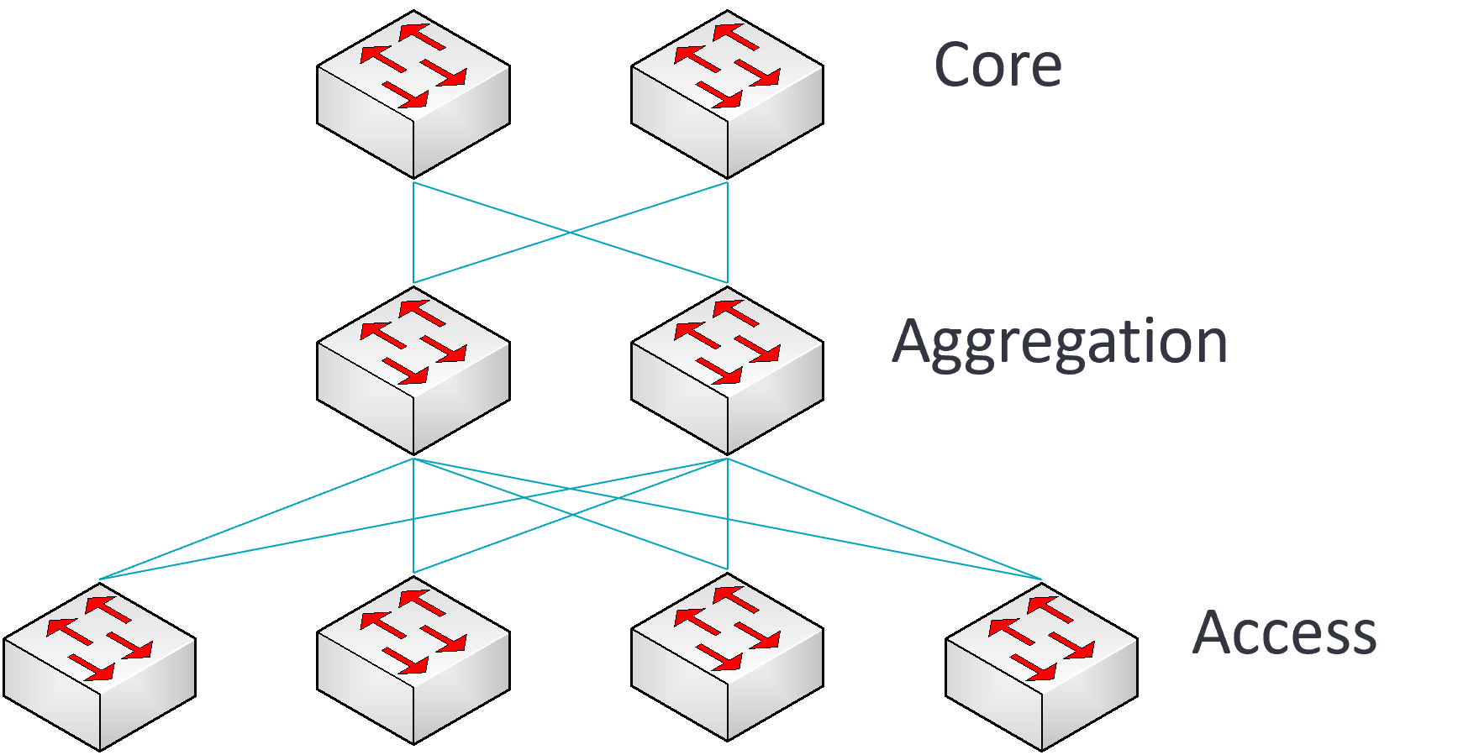
Hierarchical Design
Switched networks are often designed in a hierarchical manner
Benefits of hierarchical design include:
Modularity
Function mapping to hierarchical layer

Slide 4
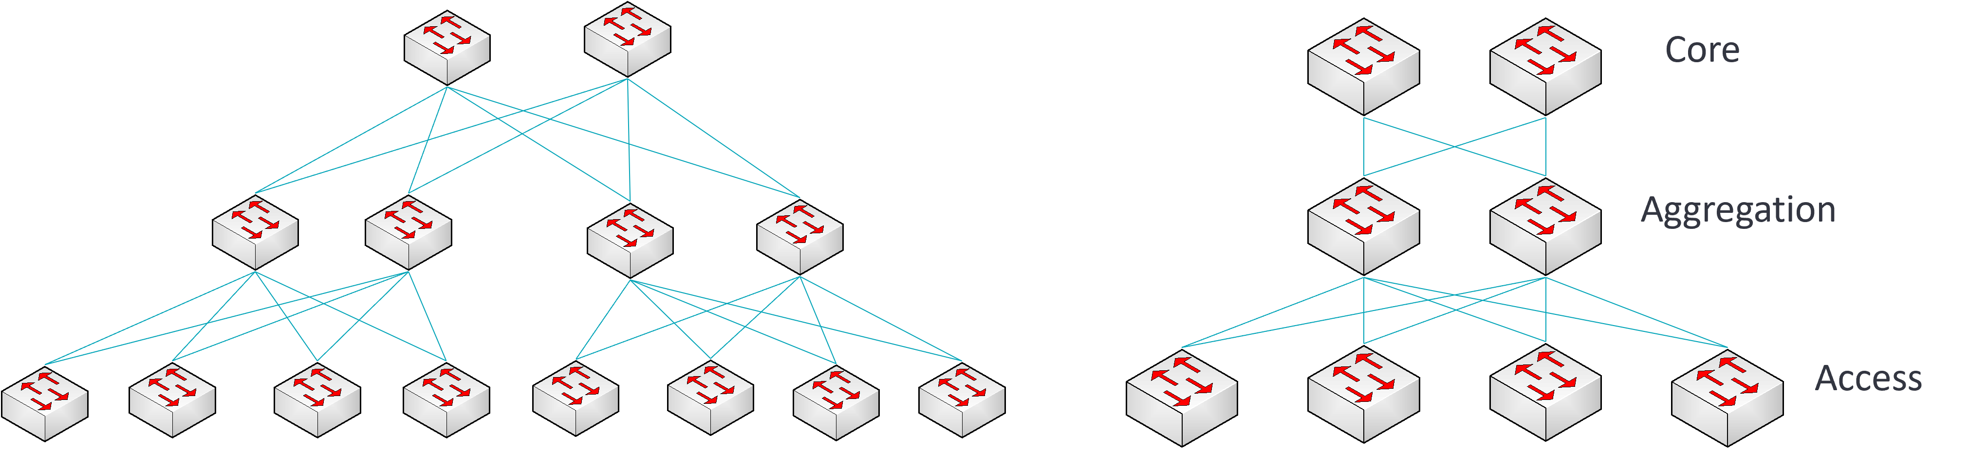
Modular Design
Due to the inherently modular design of the hierarchical network, the design is very scalable.
This allows for rapid changes to the network in a safe and consistent manner.

Slide 5
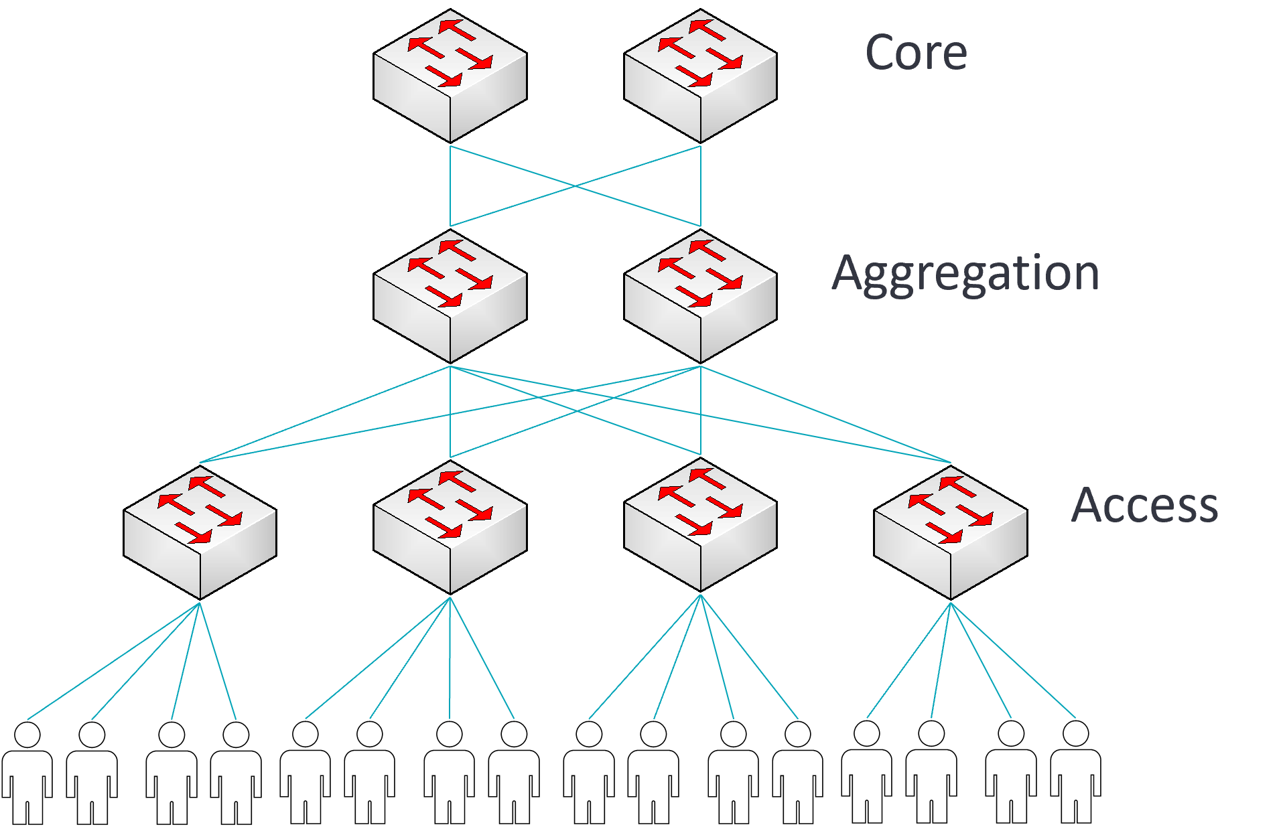
Functional Layers
In the hierarchical design, each layer has typical designated functions
This allows for fault domain isolation and much simpler troubleshooting

Slide 6
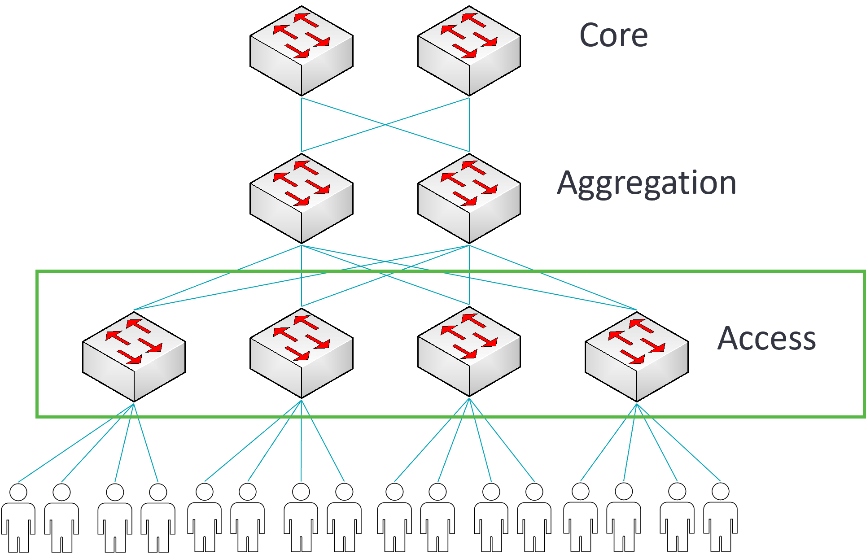
Functional Layers - Access
The access layer facilitates end-user connectivity and access policy enforcement

Slide 7
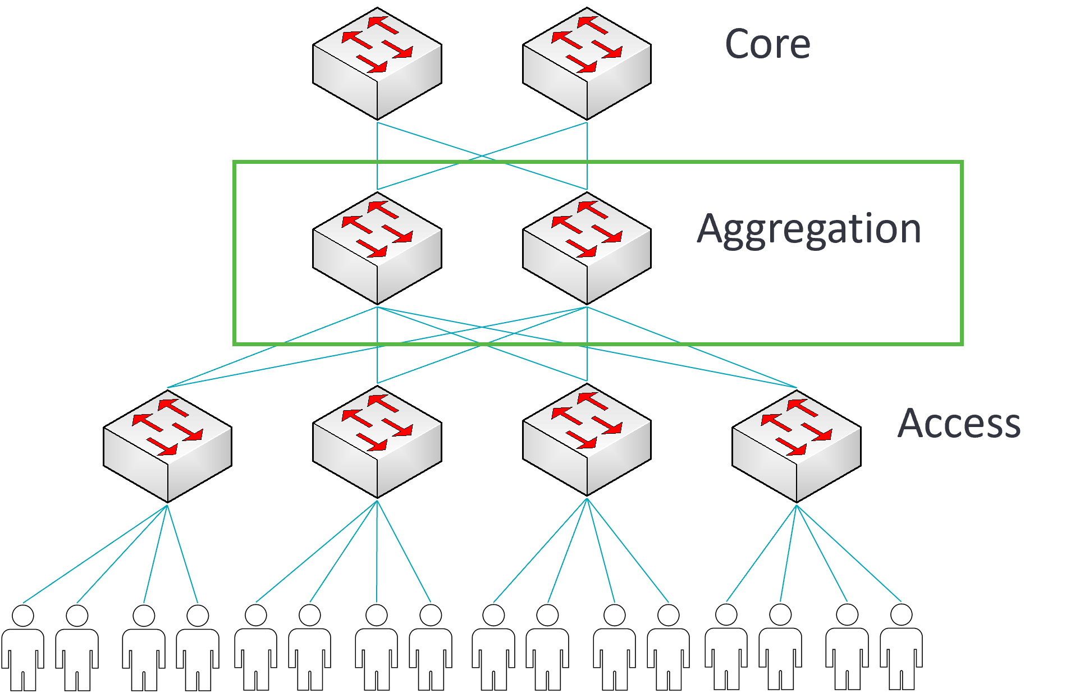
Functional Layers - Aggregation
The aggregation layer aggregates multiple access blocks and typically performs inter-VLAN routing
The aggregation layer also provides policy-based connectivity

Slide 8
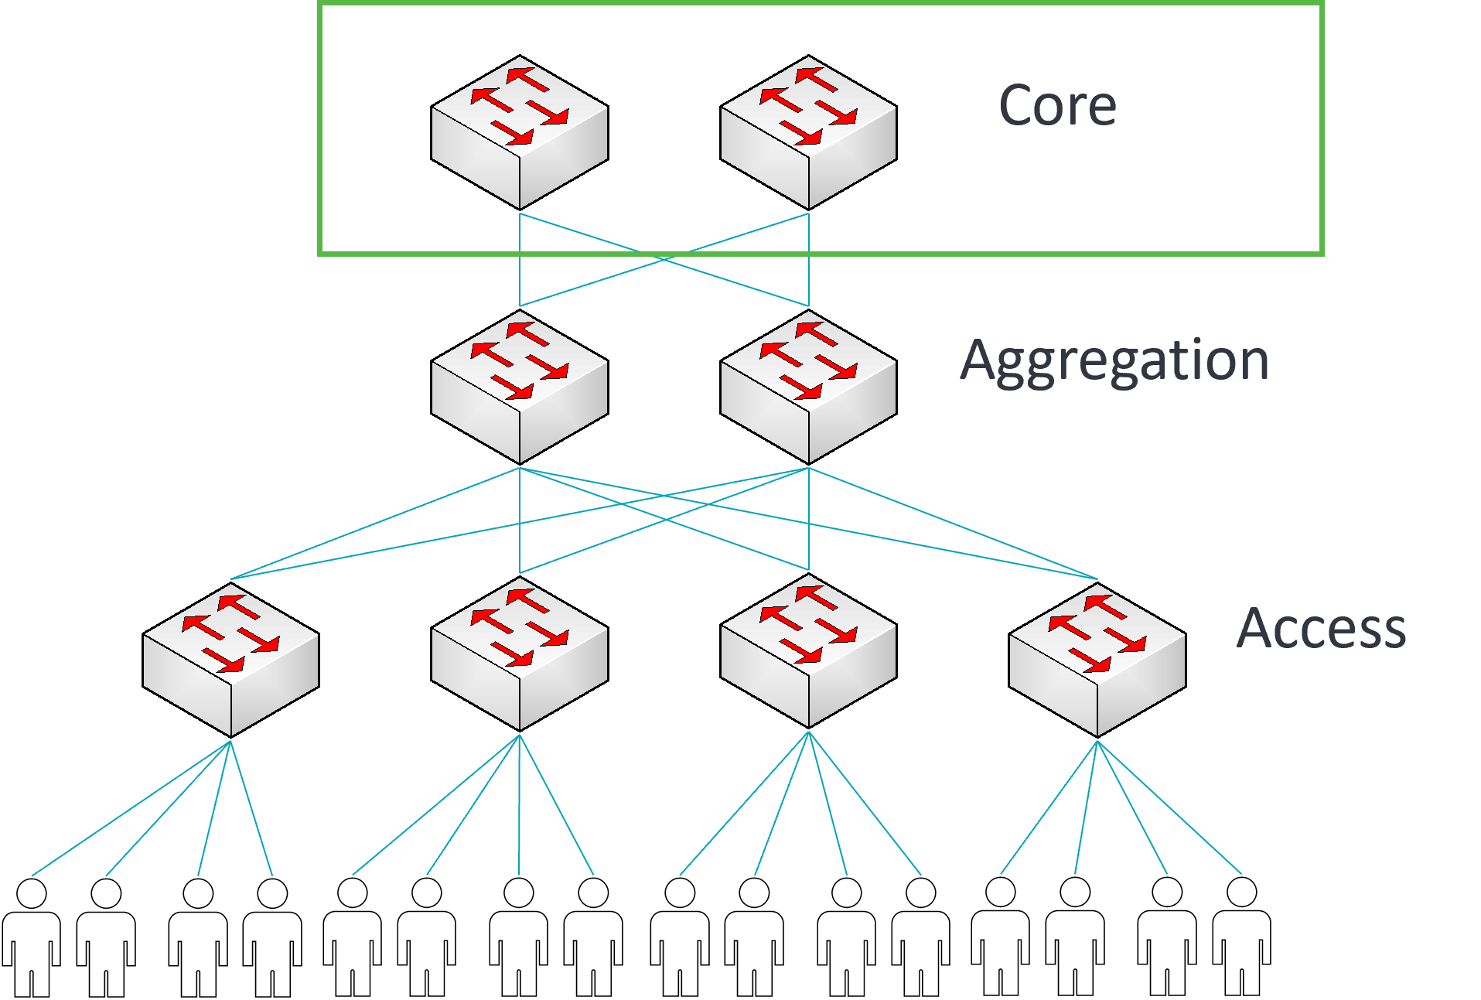
Functional Layers - Core
The core layer facilitates connectivity between aggregation modules
The WAN routing devices are typically connected to the core layer

Slide 9
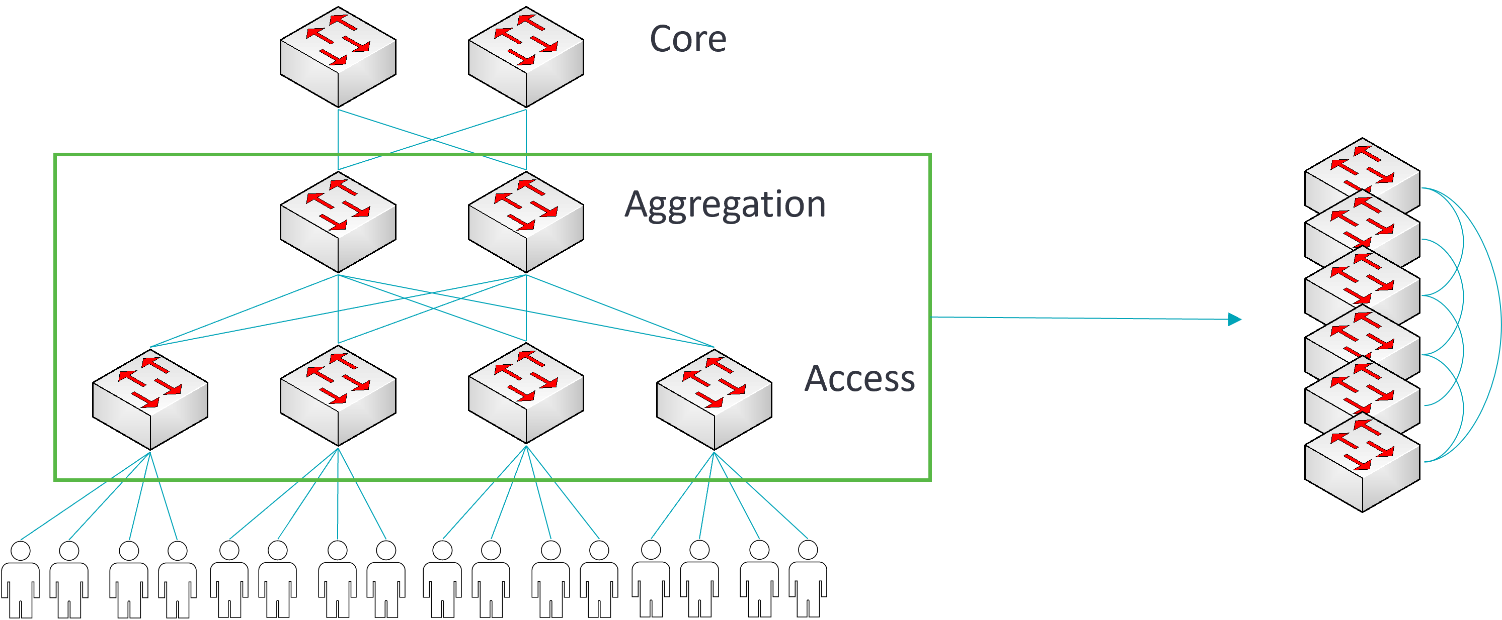
Layer Consolidation
Juniper Virtual Chassis function can allow for the consolidation of layers into a single managed chassis

